Slide 1




NEXT GEN EMPLOYABILITY PROGRAM
Creating a future-ready workforce
Team Members
College Name
Student Name : Mohan Eswaran A
Student ID : aut2241230031
Sri Ramanujar Engineering College

Slide 2

CAPSTONE PROJECT SHOWCASE
Project Title
MUSIC WEB APPLICATION USING DJANGO FRAMEWORK
Abstract | Problem Statement | Project Overview | Proposed Solution | Technology Used | Modelling & Results | Conclusion

Slide 3
Abstract
Now a days peoples more like to listen songs while working, walking or in their free time for relaxing or for taking break from this world. In old days people have to download first songs and they can listen on the device but now a days there is lots of application where you can listen a songs without downloading and also they provide search engine so people can easily find out songs but for this all services they are taking some charges. But in this application people can registration without paying any cost and there is different types of features are available in this application like people can create their own album, own playlist, etc. also in this app people can download songs so while offline they can listen songs without any interrupt. The system is build fully in Django Framework in back-end and HTML, CSS in front-end. It has similar features as popular music streaming service “Spotify” where music creators share their music through this app and other users can listen to their music or whole album. This app also provides features of downloading the music so the users can stream music even when they are offline. It is free to register for any user and they all can share their music to the world.
Source :

Slide 4
Problem Statement
Design and develop a music web application using Python that provides users with an intuitive and interactive platform to discover, listen to, and manage their favorite music tracks. The application should offer a seamless user experience with features including but not limited to:
1. User Registration and Authentication:
Allow users to register accounts securely.
Implement authentication mechanisms to ensure user data privacy and security.
2. Music Library Management:
Enable users to upload, organize, and manage their music library.
Support various audio file formats for upload and playback.
3. Music Discovery:
Implement recommendation algorithms to suggest music based on user preferences, browsing history, and listening habits.
Provide browsing capabilities such as genre-based exploration, artist profiles, and trending tracks.
4. Streaming and Playback:
Enable smooth streaming and playback of music tracks with minimal buffering.
Implement controls for play, pause, skip, and volume adjustment.
Support features like repeat, shuffle, and creating playlists.
5. Search Functionality:
Implement a robust search feature allowing users to find specific songs, albums, artists, or genres quickly.
6. Social Features:
Enable users to share their favorite tracks, playlists, and recommendations with friends.
Implement social features like following other users, commenting on tracks, and liking/disliking songs.
Source :

Slide 5
8. User Interface and Design:
Create an intuitive and visually appealing user interface (UI) with responsive design to ensure compatibility across devices.
Ensure accessibility and usability for users with diverse needs.
9. Performance and Scalability:
Optimize application performance to minimize latency and ensure smooth user interactions.
Design the application architecture to scale efficiently as the user base and content library grow.
10. Security:
Implement measures to protect user data, prevent unauthorized access, and secure communication between the client and server.
Apply best practices for data encryption, secure authentication, and protection against common security threats like XSS and CSRF attacks.
11. Testing and Quality Assurance:
Conduct thorough testing to ensure the functionality, performance, and security of the application.
Implement automated testing procedures and perform manual testing to identify and resolve any issues.
Deployment and Maintenance:
Deploy the application on a reliable hosting platform, ensuring high availability and scalability.
Provide ongoing maintenance and support to address bugs, add new features, and incorporate user feedback.

Slide 6
Project Overview
Frontend Design (HTML & CSS):
The frontend of the music website is designed using HTML for structuring the content and CSS for styling and layout.
HTML templates are utilized to create different pages such as the homepage, artist profiles, album pages, and user dashboard.
CSS is used to style various elements including fonts, colors, layout, and responsiveness for different screen sizes.
Components like navigation bars, search bars, and player controls are designed and styled using HTML and CSS.
Backend Development (Django):
Django, a Python web framework, is used for the backend development of the music website.
Django provides features such as URL routing, view functions, models, and templates rendering, facilitating rapid development and clean code organization.
Models are created to represent database tables for entities such as users, artists, albums, songs, playlists, and user interactions.
Views are implemented to handle user requests, interact with the database, and render HTML templates.
Django's built-in authentication system is utilized for user registration, login, and authentication functionalities.
Database Management:
Django uses an object-relational mapping (ORM) layer to interact with the database.
A relational database management system (such as SQLite, PostgreSQL, or MySQL) is chosen to store data related to users, music tracks, playlists, and other entities.
Database migrations are managed using Django's built-in migration tool to keep the database schema in sync with the changes in models.
Source :

Slide 7
Music Data Handling:
Music metadata such as artist name, album title, genre, and track duration are stored in the database.
File uploads or links to audio files are stored in a designated location or as URLs, and references to these files are maintained in the database.
Integration with external APIs (such as music metadata providers or streaming platforms) may be implemented to fetch additional information about artists, albums, or tracks.
User Interactions and Features:
Users can register accounts, log in, and log out securely using Django's authentication system.
Features for browsing music content, searching for specific tracks or artists, and discovering new music based on genres or recommendations are implemented.
Users can create, edit, and delete playlists, add songs to their playlists, and manage their music library.
Social features such as following other users, liking or commenting on tracks, and sharing music content may be included to enhance user engagement.
Security and Authentication:
Django's built-in security features, including protection against common web vulnerabilities like CSRF (Cross-Site Request Forgery) and XSS (Cross-Site Scripting), are utilized.
User passwords are securely hashed using strong cryptographic algorithms to protect user accounts.
Access control mechanisms are implemented to restrict certain functionalities or content based on user roles and permissions.
Deployment and Hosting:
The completed music website can be deployed on a hosting platform such as Heroku, AWS, or DigitalOcean.
Deployment configurations and settings are adjusted to ensure proper functioning in a production environment.
Continuous integration and deployment (CI/CD) pipelines may be set up to automate the deployment process and ensure smooth updates.

Slide 8
Proposed Solution
User Authentication and Registration:
Users can register for accounts securely and log in using Django's authentication system.
Passwords are hashed for security, and users receive confirmation emails for account verification.
Homepage and Navigation:
The homepage displays featured artists, trending tracks, and recently added albums.
Navigation bars and search functionality allow users to explore different sections of the website easily.
Artist Profiles and Albums:
Each artist has a dedicated profile page showcasing their biography, discography, and popular tracks.
Users can browse through albums, view tracklists, and listen to previews.
Music Library Management:
Registered users have access to their personalized music libraries.
They can upload their music files, create playlists, and organize their collections.
Music Discovery and Recommendations:
The website suggests music based on user preferences, browsing history, and listening habits.
Recommendations include similar artists, related albums, and personalized playlists.
Streaming and Playback:
Users can stream music tracks directly on the website with a built-in audio player.
Playback controls allow users to play, pause, skip tracks, adjust volume, and toggle shuffle/repeat modes.
Social Features:
Users can follow other members, discover their playlists, and share music recommendations.
Social interactions like commenting on tracks, liking/disliking songs, and reposting content enhance user engagement.
Responsive Design and Accessibility:
The website is designed to be responsive, ensuring optimal viewing experience across devices and screen sizes.
Accessibility features are implemented to accommodate users with disabilities, including screen readers and keyboard navigation.
Source :

Slide 9
Database Management and Performance Optimization:
Django's ORM is used for database management, ensuring efficient storage and retrieval of music data.
Database queries are optimized to minimize latency and improve website performance.
Security Measures:
The website employs security best practices to protect user data and prevent unauthorized access.
Measures include HTTPS encryption, CSRF protection, input validation, and secure password storage.
Deployment and Scalability:
The website is deployed on a reliable hosting platform, ensuring scalability and high availability.
Deployment configurations are optimized for performance, and monitoring tools are implemented to track website metrics.
Source :

Slide 10


Technology Used
Front-end
Back-end
Source :

Slide 11
Modelling & Results
Modeling:
User Model: The User model provided by Django's built-in authentication system is utilized for user registration, login, and authentication.
Music Model: This includes models for Artists, Albums, Songs, and Playlists. Each model represents the corresponding entity in the database, storing attributes such as artist name, album title, song duration, etc.
Social Model: Models for Followers, Comments, Likes, and Shares enable social interactions among users, allowing them to follow each other, comment on tracks, like/dislike songs, and share music content.
Database Schema:
The database schema is generated based on the models defined in Django's models.py file.
Django's migration system is used to manage database schema changes and updates.
Views and Templates:
Views are created to handle user requests and interactions, fetching data from the database and rendering HTML templates.
Templates are written in HTML and utilize CSS for styling. They contain placeholders for dynamic data that is passed from the views.
Frontend Design:
HTML templates are designed to provide a user-friendly interface for browsing music content, managing playlists, and interacting with social features.
CSS is used to style the templates, ensuring consistency in design and layout across different pages of the website.
Responsive design principles are applied to ensure compatibility with various devices and screen sizes.
Backend Functionality:
Backend functionality is implemented using Django's views, which handle user requests, process form submissions, and interact with the database.
Authentication and authorization mechanisms are implemented to ensure secure access to user data and functionalities.
Business logic for features such as music discovery, recommendations, and social interactions is implemented in the backend.
Source :

Slide 12
Results:
Users can register accounts, log in, and access personalized features such as music libraries and playlists.
They can browse artists, albums, and songs, view detailed information, and listen to music previews.
Social features allow users to follow each other, comment on tracks, like/dislike songs, and share music content.
The website provides a seamless user experience with smooth navigation, responsive design, and intuitive controls.
Performance optimizations ensure fast loading times and minimal latency, even with a growing database and user base.
Security measures protect user data and prevent unauthorized access, ensuring a safe and secure environment for users.

Slide 13
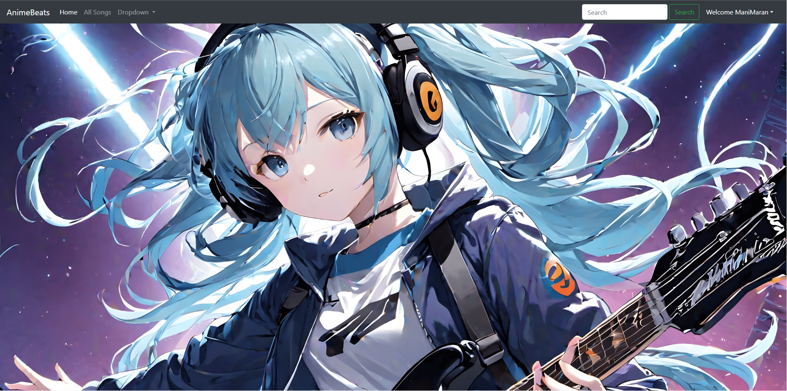
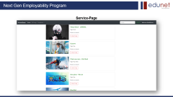
Homepage

Slide 14
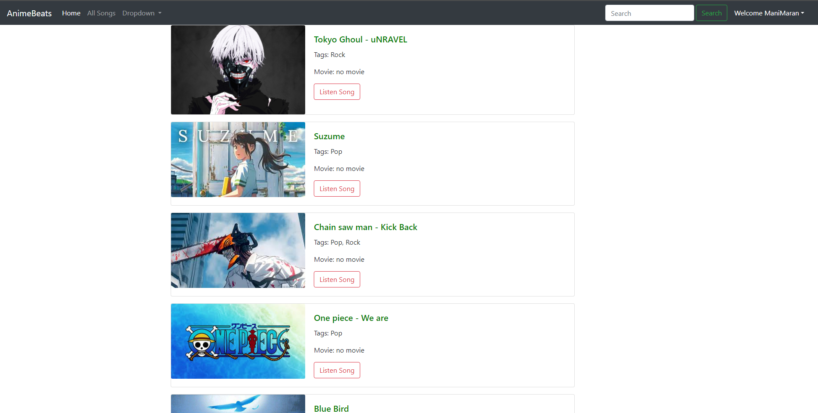
Service-Page

Slide 15
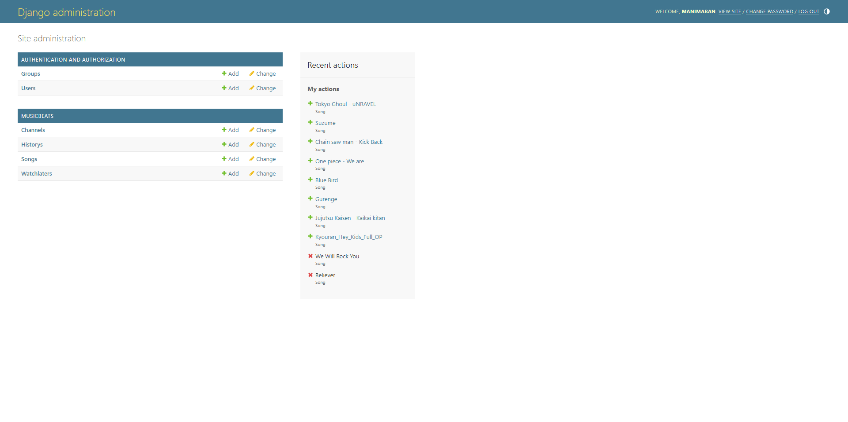
Departments-Page

Slide 16
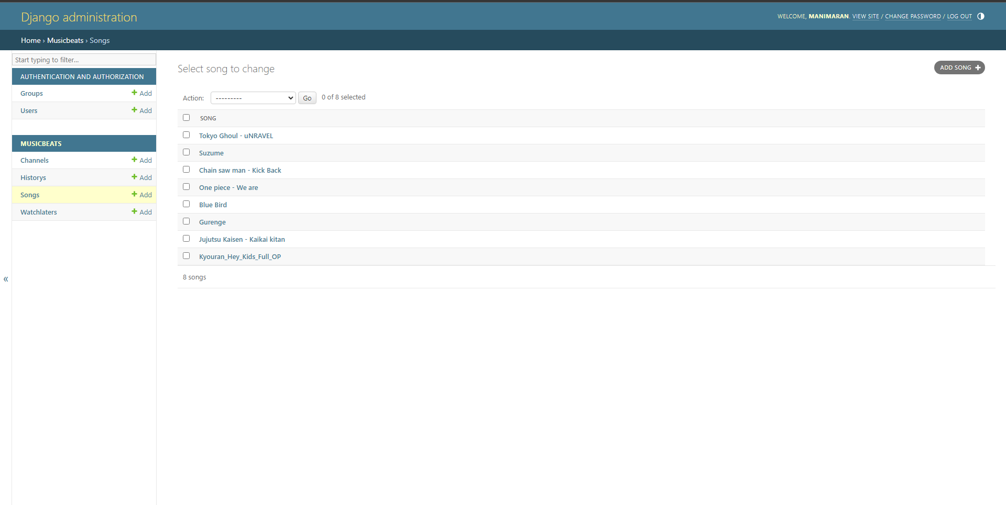
Blog-Page

Slide 17
Future Enhancements:
1. Advanced Recommendation System:
Implement machine learning algorithms to enhance the recommendation system, providing more personalized music suggestions based on user preferences, listening history, and behavior patterns.
2. Mobile App Integration:
Develop mobile applications for iOS and Android platforms, providing users with native mobile experiences and offline access to their music libraries.
3. Improved UI/UX Design:
Conduct user research and usability testing to gather feedback and identify areas for improvement in the user interface and user experience.
Implement UI enhancements, such as smoother transitions, interactive animations, and intuitive gestures, to enhance usability and engagement.
4. Live Streaming and Events:
Introduce live streaming capabilities to broadcast concerts, music festivals, and other events directly on the website, allowing users to experience live performances from their favorite artists.

Slide 18
Conclusion
In conclusion, the music website created using HTML, CSS, and Django provides a comprehensive platform for users to discover, listen to, and interact with music content. Through the combination of frontend design, backend development, and database management, the website offers a seamless user experience with a range of features and functionalities.
The integration of Django's authentication system ensures secure user registration, login, and authentication, while the database models facilitate efficient storage and retrieval of music-related data. The frontend design, crafted with HTML and CSS, offers an intuitive interface that is responsive and accessible across various devices and screen sizes.
Key features such as music library management, music discovery, streaming and playback, and social interactions enrich the user experience, allowing users to explore a diverse catalog of music, create personalized playlists, and engage with other members of the community.
Looking ahead, future enhancements such as advanced recommendation systems, enhanced social features, mobile app integration, and live streaming capabilities can further elevate the website's functionality and user engagement. Continual improvements in UI/UX design, accessibility, and multilingual support will ensure that the website remains relevant and accessible to a diverse audience.
Overall, the music website serves as a valuable platform for music enthusiasts to connect, discover new artists, and enjoy their favorite tracks, while maintaining high standards of security, performance, and usability. With ongoing development and innovation, the website has the potential to evolve and thrive in the ever-changing landscape of digital music consumption.
Source :

Slide 19
Thank You!
Notes:
Thank You !!

